Slide 1
WELCOME!
The Annual Meeting of the Belden Maintenance Corporation
Hosted by Your 2017 Volunteer Board of Directors
Please help yourself to dinner while we wait for more community members to join us

Slide 2
Agenda
Review of this evening’s voting
A short history of Belden
Summary of 2017 Board accomplishments
Financial update
Landscaping business
Architectural Review Committee Reminders
Capital Improvement
Results of voting

Slide 3
Tonight’s Necessary Votes
Election of the 2018 Board of Directors
Approval of the 2018 Annual Assessment
Capital Improvement Phase One
Belden Group Trash/Recycling Program

Slide 4
The History of our Community
Sapphire Lakes broke ground in 2007 to sell 87 Homes in a community called BELDEN
Comprised of 2 different builders: Handler and Anderson Homes
Anderson homes left Belden community around 2010 and since then Handler picked the remaining lots to build and sell
From the developers perspective: The first home was sold in March 2008 and the last one sold was in March 2017

Slide 5
Summary of 2017 Board Accomplishments
Amended Deed Restrictions
      Recorded our First Amendments in New Castle County Recorder of Deeds
      Retained attorney for above required work
      This now applies to all 87 homes
Belden Maintenance Corp: 2017 Taxes
      Filed Belden HOA Annual Tax Return
      Filed Belden HOA Delaware Annual Franchise Fee

Slide 6
Summary of 2017 Board Accomplishments
HOA Assessment
  Passed Calendar year 2017 Annual HOA assessment (with homeowner approval)
  Retained New Castle county to handle all annual HOA payments
Capital improvement Fund
  Originally deposited in Vanguard 500 Index
  (Admiral)
  Now deposited in Vanguard Total Bond Index
  (Admiral)
  Rate of return has been 5.7%

Slide 7
Summary of 2017 Board Accomplishments
Homeowner architectural changes
  Architectural Review committee reviewed various homeowner projects such as
  decks, fences, patios, swimming pools, enclosures and passed onto board
  Board has approved more than 20 such requests since last HOA Meeting
Landscaping services
  Retained Addalli for maintaining our landscape for Calendar year 2017

Slide 8
Summary of 2017 Board Accomplishments
Snow removal
  Received quotes from multiple vendors regarding snow removal
  Finalized 1 year contract with Addalli
Waste management
  Able to retain and preserve a steep discount with Waste Management for
  weekly trash/recycling and summer biweekly yard waste pickup
  Collected yearly waste management annual fees on behalf of homeowners to
  send to Waste management

Slide 9
Summary of 2017 Board Accomplishments
Bioswales inspection
  Passed New Castle County Annual Bioswales inspection
  Contracted Addalli to clean up the Bioswales for NCC Summer inspection
  program.

Slide 10
2017 FINANCES
Income | Budget | Actual
Assessment | $ 42,450.00 | $ 41,407.84
Snow removal reimbursement | $ 2,250.00 | $ -
Fines | $ - | $ -
Miscellaneous | $ - | $ -
Total Income | $ 44,700.00 | $ 41,407.84
Expenses | Budget | Actual
Bank Fees | $ 50.00 | $ 31.00
Business Expenses | $ 500.00 | $ 525.00
PO box rental | $ - | $ -
Insurance | $ 750.00 | $ 668.00
Annual Meeting Expense | $ 550.00 | $ 190.60
Franchise fee | $ 25.00 | $ 25.00
Property Taxes | $ 62.00 | $ 61.50
Income Tax | $ - | $ 53.78
Capital Improvement Fund | $ 4,500.00 | $ 2,000.00
Accounting | $ 300.00 | $ -
Lawn Maintenance | $ 19,400.00 | $ 18,868.00
Snow Removal | $ 3,750.00 | $ 265.00
Misc Maintenance | $ 1,000.00 | $ 1,110.00
Water | $ - | $ -
Electric | $ 170.00 | $ 158.86
IT Maintenance | $ - | $ -
Total Expenses | $ 31,057.00 | $ 23,956.74
01 Jan17 Balance: $53,701 Increase of $5,333 over 01Jan16
Balance as of 23 Oct: $71,152
Landscaping is the biggest expense at $23,585 a year
Received full assessment payments from 83 lots as of 23 Oct. 86 lots paid in 2016.
Books are open to any member-Just ask!

Slide 11
2018
Budget Income
Assessment | $ 41,890.00
Snow removal reimbursement | $ 3,000.00
Fines | $ -
Miscellaneous | $ -
Total Income | $ 44,890.00
Budget Expenses
Bank Fees | $ 60.00
Business Expenses | $ 600.00
PO box rental | $ 325.00
Insurance | $ 750.00
Annual Meeting Expense | $ 850.00
Franchise fee | $ 25.00
Property Taxes | $ 62.00
Income Tax | $ 50.00
Capital Improvement Fund | $ 4,500.00
Accounting | $ 300.00
Lawn Maintenance | $ 24,200.00
Snow Removal | $ 5,000.00
Misc Maintenance | $ 1,000.00
Water | $ -
Electric | $ 210.00
IT Maintenance | $ 200.00
Total Expenses | $ 38,132.00
Anticipate $61,119 to start off FY18 ($53,701 in FY17)
Landscaping is the biggest expense
Snow removal variable expense; a portion is reimbursed by the county
Budgeted Net Gain: $6,758

Slide 12
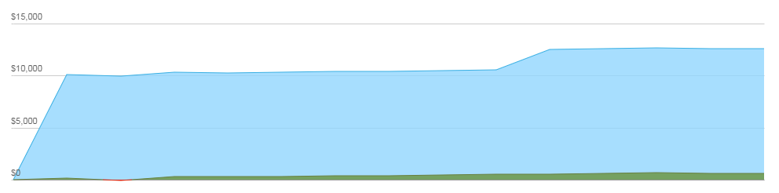
Capitol Improvement Fund Vanguard Admiral 500 Index
Shares: 1,169.622
Price as of 23 Oct: $10:77
Value: $12,596.83
Net gain: $596.83
Rate of return: 5.7%

Slide 13
2018 Annual Assessment
Assessment for Maintenance of Common Areas, Operating Expenses, Capital Improvements
Assessment To Be Collected by New Castle County
            Bills will be mailed in March with a due date in April
2018 Assessment amount = $500
Needs approval by a majority at the meeting

Slide 14
LANDSCAPING
Trees
  Handler (contract not signed)
  2018 Federal Grant (will pursue tree plan throughout community)
Landscape services
  2018 Bids
Group Waste Removal

Slide 15
Architectural Review Committee
Chair: Rob Reichelmann
Members: Chris Ciupinski, Josh Farside, Scott Reiter, Joe Sharpe
Projection Submission Overview:
  Download Application form from the ARC Website
  Read all instructions and provide complete submissions
  Email Package to: Rreichelmann@t2s-solutions.com or beldenboard@emaildodo.com
DEED Restrictions state that the process take no longer than 30 days for complete submissions
Do not start projects without HOA Approval (Thanks)
ARC Website: https://www.beldenhoa.org/architectural-review
Contact me if you would like to volunteer for the ARC!

Slide 16
Forms and Deed Restrictions

Slide 17
CAPITAL IMPROVEMENT:
History and Meaning
Belden originated in 2007
  Anderson and Handler sold under many unfulfilled capital “promises”
    i.e. 5 mile walking trail, playground on Testaverde
Handler was in control until just last year
  Capital improvement achieved through Handler from 2007 through 2016 = NONE
Purpose of Capital Improvement
  To increase the value of living in Belden
    Getting the most out of where we call home
    i.e. increased function, pleasant aesthetics

Slide 18
First Proposed Capital Improvement Initiative: January 2018
¼ mile paved, loop walking trail maximizing the designated recreation area and open space on Testaverde Rd. and behind
Trees planted behind trail- increased privacy for residents
2 stone benches installed on trail for resting/conversation area
Pros:
  Less foot traffic on our limited road space
  Increase safety
  More peaceful, enjoyable walking space for residents

Slide 19
Capital Improvement Phase one: Process
An informal capital improvement committee was formed in 2017
Ideas and feedback were shared throughout the process
4 different landscape companies were walked through the open space and submitted quotes
BJS Nursery was chosen as the partner for this project
  Submitted lowest quote ($30,750)
  Highly recommended by neighbors from past project satisfaction

Slide 20
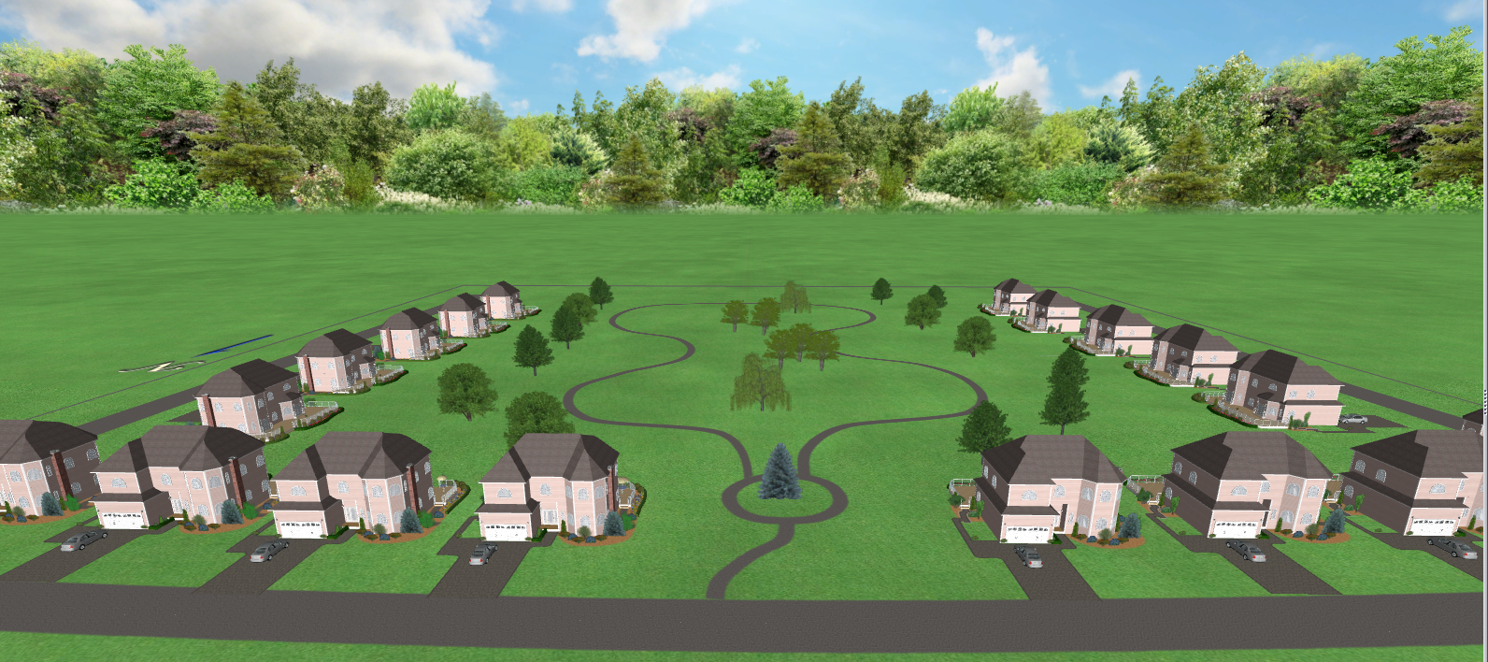
Walking Trail Draft
Trails will be at least 60 ft away from property lines (or 160 ft from house)
40 trees will be planted to add privacy around the trail, including: River birch, Willow, Flowering cherry trees, Blue spruce, and Green Giant Arborvitaes

Slide 21
VOTES and Board Nominations
Please submit your votes at this time
for the following items:
  Annual Dues
  Walking Trail
  Trash Program
If you would like to nominate yourself to participate in the 2018 volunteer Board of Directors, please come forward

Slide 22
Final Vote
Please submit your vote for the 2018, 5 designated board members at this time

